Slide 1
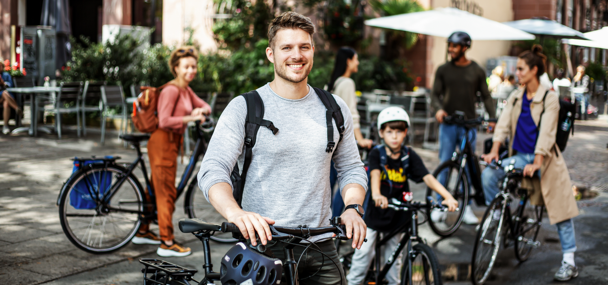


Photo: Climate Alliance Services
Notes:
CITY CYCLING is a campaign by Climate Alliance.

Slide 2
Keep it short!
All of the different components of the CITY CYCLING campaign are outlined in this presentation – it is therefore quite long.
Be sure to consider your audience’s attention span and to only include the slides that you really need and that are interesting and relevant to them.
You can answer questions from the audience afterwards.
PLEASE NOTE: More detailed information is provided in the notes section!
Notes:
Be sure to also check the notes section for more information!

Slide 3




CITY CYCLING
Overview
Notes:
CITY CYCLING essentially comprises three components:
CLICK 1: The core CITY CYCLING campaign.
CLICK 2: The Schulradeln campaign as a (special) competition for schools linked to or integrated into the local CITY CYCLING campaign.
CLICK 3: RADar! reporting platform as a citizen participation tool for planning cycling infrastructure. *
CLICK 4: BIKE MONITOR: A portal for cycling traffic data in Germany, revamped for 2025: This digital service for German CITY CYCLING municipalities will allow them to better plan bicycle infrastructure using meaningful cycling traffic data (see presentation from Slide 32 onwards). *
* These services are currently only available to municipalities in Germany.

Slide 4

CITY CYCLING, RADar! & BIKE MONITOR
Successfully shaping the mobility transition
Notes:
All three components have in common that they aim to help municipalities to successfully shape the mobility transition.

Slide 5

Notes:
About CITY CYCLING ...

Slide 6

Photo: Climate Alliance Services
More people
cycle more!
What is CITY CYCLING?
Competition to promote cycling, help protect the climate and enhance the quality of life in municipalities
Notes:
CITY CYCLING is a competition to promote cycling, help mitigate climate change and enhance the quality of life in municipalities.
All municipalities are invited to participate – whether a town, city, municipality or rural district/region.
CLICK: Ultimately, the aim is to offer a fun approach to help municipalities motivate more people to cycle more.
N.B.: Further texts are concealed behind the green field that will only be visible when the presentation mode is launched!

Slide 7
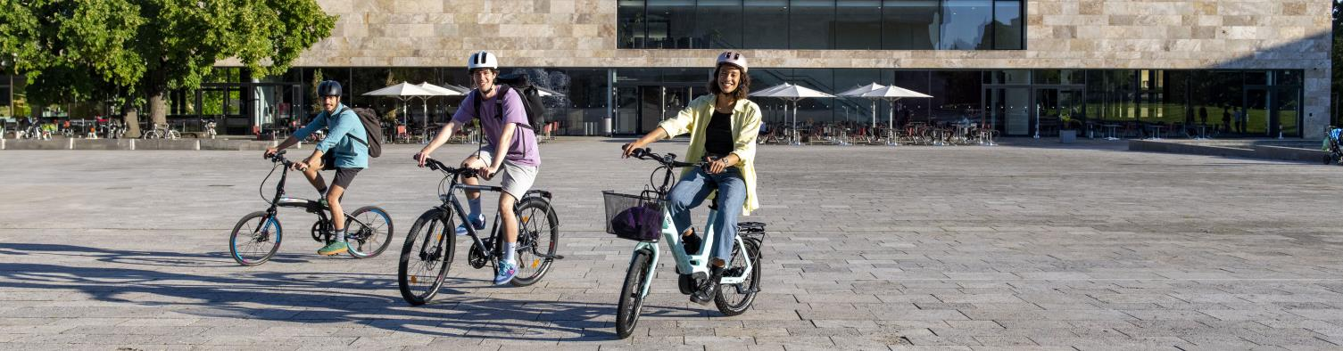
Photo: Climate Alliance Services/ Felix Krammer
How does it work?
Cycle as many kilometres as possible for business and leisure
Everyone can join in
Cyclist form teams
Notes:
During the CITY CYCLING campaign, people should cycle as many kilometres as possible – whether for business or leisure.
ANYONE can participate and form a team: whether young or old, a student or employee, daily or occasional cyclist ...
The only requirement is that they must live or work, belong to an association or club, or attend a school or university in the participating municipality.

Slide 8
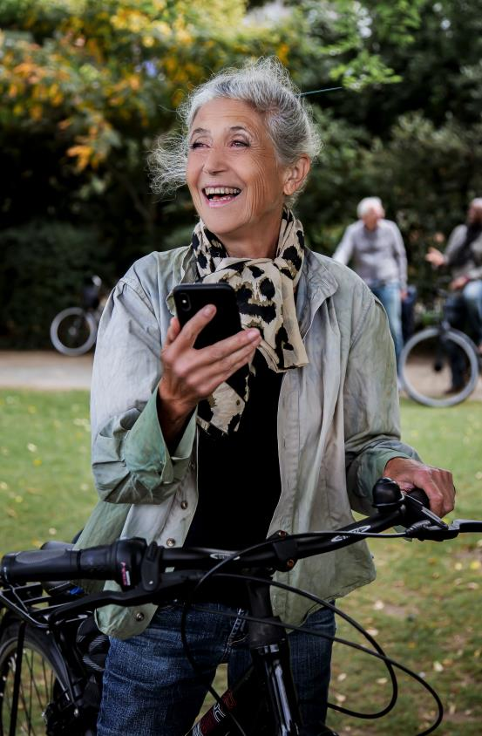
How does it work?
CITY CYCLING campaign season 1 May to 30 September
Local campaign period 21 consecutive days
Enter kilometres online or use the CITY CYCLING app to track them
Photo: Climate Alliance Services
Notes:
Municipalities are free to decide for themselves when the 21-day local campaign should take place during the annual campaign season that runs from 1 May until 30 September.
The kilometres cycled can be entered on the CITY CYCLING website or tracked directly using the CITY CYCLING app.

Slide 9

Target group
Political decision-makers
Long-term improvement of the cycling infrastructure!
Take the cyclist’s perspective
Demonstrate proximity to citizens
Set a good example
Citizens exert political “pressure”
Perceive cyclists as voters
Photo: Climate Alliance Services / Felix Krammer
Notes:
One unique feature of the campaign is that the local decision-makers, as the ones responsible for the local cycling infrastructure, are invited to actively participate in CITY CYCLING. The aim is for them to experience cycling in their local area, gain first-hand experience and learn where improvements are needed. At the same time, they should consciously serve as role models (also see the next slide on CYCLE STARS) and encourage their fellow citizens to use sustainable, future-proof mobility.
For their part, citizens should send a clear message to politicians with their participation and every kilometre they cycle that cycling should be promoted more.
CLICK: The aim: To raise awareness among political decision-makers of the need to improve the cycling infrastructure.
N.B.: Further texts are concealed behind the green field that will only be visible when the presentation mode is launched!

Slide 10

CYCLE STARS
Leading by example
21 days only by bike – absolutely no travel by car!
If possible, a “local celebrity” and media coverage
Regular experience reports in a CITY CYCLING blog
Photo: Climate Alliance Services / Felix Krammer
Notes:
The special CYCLE STAR category is also intended to help generate (even more) media coverage of CITY CYCLING and awareness of bicycles as an alternative mode of transport.
All CYCLE STARS to successfully participate in CITY CYCLING will receive a top-quality prize from our partners and supporters at the end of the campaign season (see city-cycling.org/prizes).
For more information, see city-cycling.org/star.

Slide 11
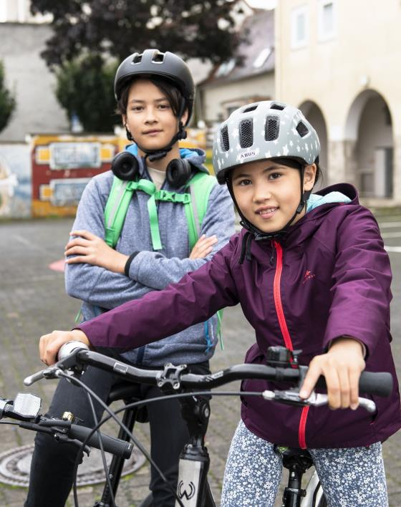

Schulradeln
The competition within the competition
Special competition within CITY CYCLING for schoolchildren in Germany. So far offered in:
▪ Baden-Württemberg ▪ Bavaria
▪ Hesse ▪ Lower Saxony
▪ North Rhine-Westphalia ▪ Rhineland-Palatinate ▪ Saarland ▪ Thuringia
Special focus on: schoolchildren, parents and teachers from primary schools to vocational colleges
Creative competitions possible
Awards within the federal states, in part by (state) ministers
Growing popularity
– increasingly important!
Photo: Climate Alliance Services / Felix Krammer
Notes:
Increasingly popular and important, as crucial target groups receive special attention:
Schoolchildren: their future mobility behaviour is shaped decisively at a young age.
Teachers: reduce commuter traffic, act as role models, raise awareness for sustainable mobility and better cycling infrastructure – especially with regard to parking facilities.
Parents: combat the “parent taxi” phenomenon, children have a positive influence on parents, reduce the daily traffic chaos and associated dangers outside schools.
For all children – from primary schools through to vocational colleges. Can be accompanied by their parents before they’ve completed their cycling proficiency test (usually in Year 4).
The best schools within each federal states are sought, so the schools to cycle the most kilometres (absolute), collect the most kilometres per cyclist (average) and/or motivate the most people to participate. Schools can compare themselves with other schools in their municipality, the entire federal state and across Germany.
Creative competitions can also be implemented in schools and prizes conferred accordingly: school projects and campaigns on cycling/sustainable mobility. Funny, creative ways to combine cycling and school: can be sporty, artistic, scientific or even something completely different. As long as the focus is on cycling!

Slide 12

Schulradeln
How does it work?
Takes place during the local CITY CYCLING campaign
Link to Schulradeln while registering for CITY CYCLING
Subteams for individual classes within a school for added motivation
Federal states responsible (annual licence)
State coordinators responsible for overall coordination
Photo: Climate Alliance Services
stadtradeln.de/schulradeln
Notes:
Schulradeln automatically takes place during the 21-day local CITY CYCLING period, so the kilometres cycled by schools are also added to the CITY CYCLING total for the municipality.
When registering for CITY CYCLING, schools in the municipality can be selected from a dropdown list (the state coordinators provide and maintain an Excel list of all schools in the federal state). Allowing schools to be clearly registered and avoid multiple registrations.
The subteam option is particularly interesting for schools: If a school is registered as the main team, individual classes can then form subteams – to encourage competition within the school itself, for example. Schools can then also confer awards (e.g. for the best classes).
Responsibility for organisation/implementation is deliberately assigned to the federal states, if necessary also shared between ministries (ministry of transport, the environment or culture, etc.). The federal states must pay a licence fee; participation in the national competition is then free for the municipalities (and schools).
See stadtradeln.de/schulradeln for more information.

Slide 13
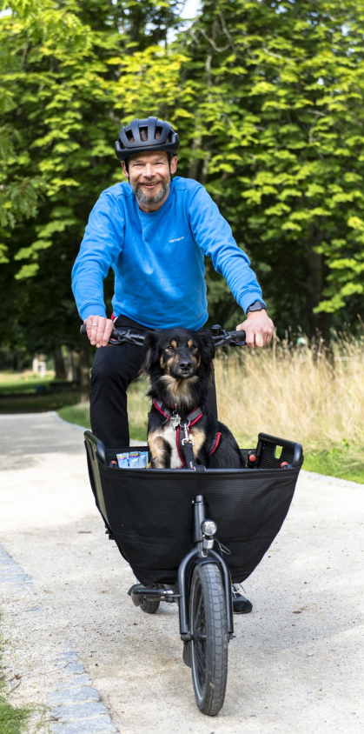






CITY CYCLING goes international
Global participation possible
Strengthen friendly ties with partner towns/cities
Photo: Climate Alliance Services / Felix Krammer
Notes:
Since 2017, the CITY CYCLING campaign has been available for implementation worldwide.
The English-language website at www.city-cycling.org is not only intended for non-German speaking municipalities outside Germany, but also for non-German speakers within Germany itself.
Today, the campaign is also available in several other languages.
German municipalities can invite their partner cities to participate and thus deepen their friendly ties: direct competition “against each other” but all together for more sustainable mobility – and that across borders!

Slide 14
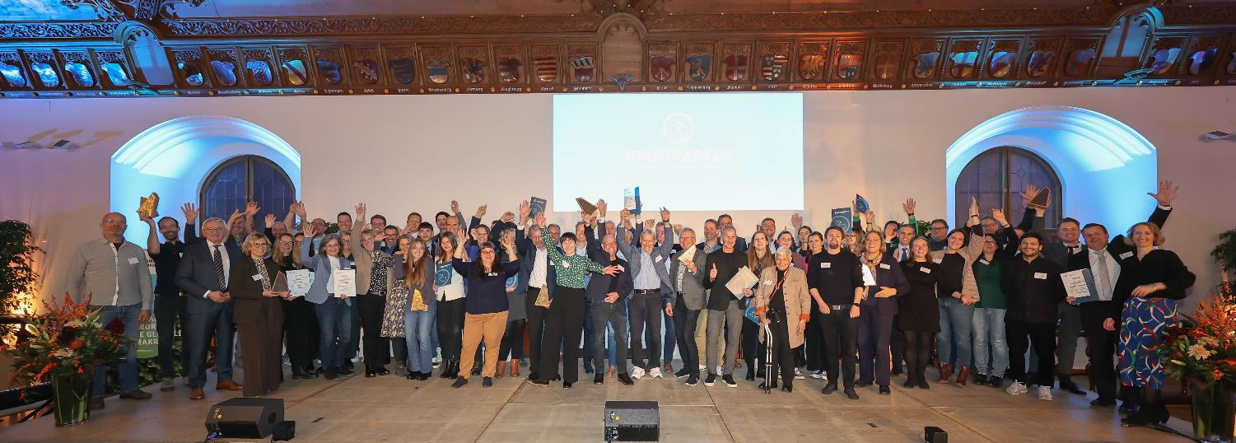
Photo: Michael Nagy / Presseamt München
Photo: Climate Alliance Services / Smilla Dankert
The winners
Who is acknowledged how?
Locally by the municipalities Teams and/or individuals
Internationally by Climate Alliance Services Most successful municipalities
Notes:
Each municipality should award prizes to its most successful teams and cyclists. Possible categories are:
Largest team: the teams with the most cyclists
Most active team: the teams to cycle the most kilometres (absolute figures)
Team with the most active cyclists: the teams with the most kilometres per cyclist (average)
Commuters and schoolchildren can also be conferred special awards, for example.
At the end of the campaign season, Climate Alliance honours the most successful municipalities during an award ceremony (see next slide).

Slide 15
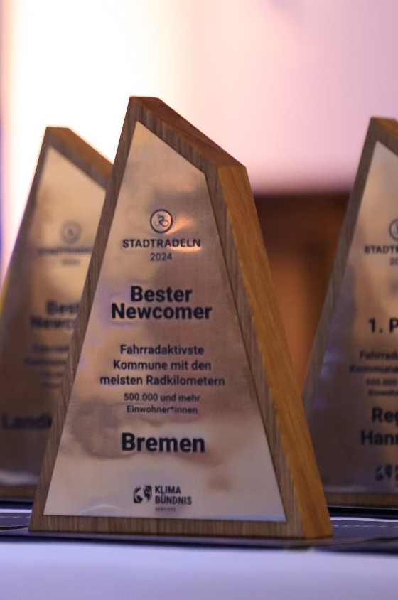
The winners
on the international level
Awards in two categories within five population groups
most active local parliaments
most active municipalities with the most kilometres cycled
First place and best newcomer in each category
Photo: Michael Nagy / Presseamt München
Photo credit: Climate Alliance Services / Smilla Dankert
Notes:
Climate Alliance Services confers prizes in the following categories:
most active local parliaments (kilometres per parliamentarian in proportion to the total parliamentarians participating)
most active municipalities with the most kilometres cycled (absolute figures)
In both categories, one winning municipality will be determined per population group (see next slide for the participation fees), along with the best newcomer in each population group.

Slide 16
Participation fees in 2025
For municipalities
Number of inhabitants | Climate Alliance members | Non-members
Less than 10,000 | € 540 | € 720
10,000 to 49,999 | € 1,075 | € 1,425
50,000 to 99,999 | € 1,785 | € 2,370
100,000 to 499,999 | € 2,675 | € 3,560
More than 500,000 | € 3,565 | € 4,740
Lump sum* | € 280 | € 370
Subsidies in Germany
available in almost all German federal states
up to 100% of the participation fees covered by state ministries
More information: city-cycling.org/register
Incl. VAT
* Registration via the rural district/region
Notes:
The population group sizes are defined here. Rural districts/regions are additionally able to register their associated municipality for a flat-rate fee.
The participation fees are calculated according to the population group sizes.
Climate Alliance members receive a discount of around 25%.
CLICK: In many German federal states, financial support is available. Details of the current subsidies are available online at city-cycling.org/register.

Slide 17
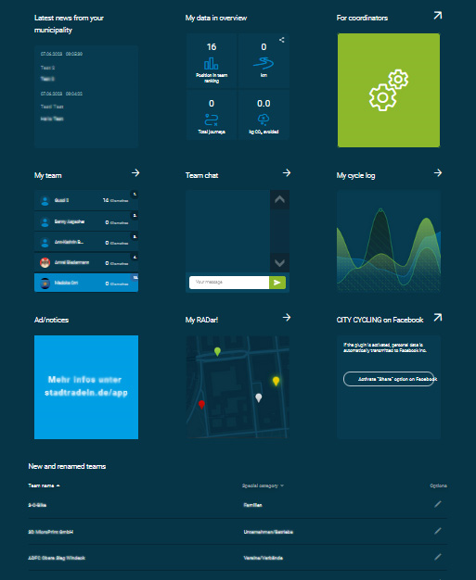
Services
For municipalities
Complete IT infrastructure incl. a municipal subpage on city-cycling.org as a hub for mobilising local participants
CITY CYCLING app incl. tracking function
Optional services (in Germany):
RADar! reporting platform
BIKE MONITOR: cycling data, presented in maps and graphs
Notes:
What do municipalities get for their money?
Climate Alliance Services provides each municipality with its own subpage on city-cycling.org. As a hub for local mobilisation, it among others includes the following functions:
personal accounts for each individual cyclist following registration to allow them to form teams, chat with fellow team members and record kilometres
display of various municipal results in real time
option of customising cyclists’ contact details, other information and dates
The free CITY CYCLING app provides all information at a glance and can be used to track kilometres.
Optional services:
free use of the RADar! reporting platform during CITY CYCLING (see from slide 24)
use of the data portal with scientifically evaluated cycling data (see from slide 31)

Slide 18






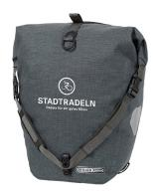
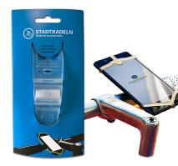

Services
For municipalities
Participation is made as easy as possible for municipalities!
Resources to help municipalities prepare and organise their local campaign
PR materials and document templates to implement the campaign
Giveaways to advertise the campaign locally
Webinars and support from Climate Alliance Services
Notes:
What do municipalities get for their money?
Materials to prepare and organise the local campaign:
Training and information materials explaining how to run the campaign and mobilise citizens
PR materials and document templates:
customisable flyer, poster and roll-up templates
photo pool
postcards
logos
certificate templates
press release templates
... and much more!
Climate Alliance is on hand to advise and offers a support hotline. It helps municipalities to support cyclists and holds webinars on CITY CYCLING
CLICK: The aim: To make implementation of the campaign as easy and efficient as possible for municipalities
N.B.: Further texts are concealed behind the green field that will only be visible when the screen presentation is started!

Slide 19

Tasks
for local coordinators
Spread the word!
Serve as the contact person for the local population, cyclists and teams, Climate Alliance Services
Organise the local campaign
Tip: Establish an organising team
Photo: Climate Alliance Services
Notes:
Advertising via (local) media partners, website, newsletter and official gazette, social media, police, etc. and personal approach through and with businesses, retailers, associations, schools, universities, day-care centres, political decision-makers, etc.
Each CITY CYCLING municipality must appoint at least one local contact person. They are responsible for PR for the campaign and for encouraging citizens to participate. They are also available to answer cyclists’ questions and are at the same time in contact with Climate Alliance. During and after the local campaign period, they check the kilometre entries, specifically for anomalies and for members of the local parliament.
Tip: Establish a CITY CYCLING organising team involving members of local administration and potentially also people from other departments, climate managers, press officers and/or city marketing staff – ADFC, VCD, Agenda 21 as well as other obvious interest groups in the municipality along with committed citizens. Synergies can and should be tapped into and tasks shared! Agencies can also be commissioned to implement the campaign.

Slide 20
CITY CYCLING
A success story
Participating municipalities
Notes:
116 municipalities more in 2024 than in the previous year!
The municipalities participating in CITY CYCLING cover around 90% of the population in Germany, as almost all large cities participate: all but two cities with more than 65,000 inhabitants participate in CITY CYCLING!
The latest figures can always be viewed online at city-cycling.org/results.

Slide 21
CITY CYCLING
A success story
Participating cyclists
Notes:
In 2024, there were more than 1 million participants in CITY CYCLING.
The latest figures can always be viewed online at city-cycling.org/results.

Slide 22
CITY CYCLING
A success story
Kilometres cycled
Notes:
The changeable, at times very rainy summer of 2024 left its mark with a slight drop in the number of kilometres cycled. Participants still averaged over 190 km per person during the three CITY CYCLING weeks – that’s around 9 km per day. The latest figures can always be viewed on city-cycling.org/results.

Slide 23
city-cycling.org
Notes:
More information is available online at city-cycling.org.

Slide 24
Notes:
RADar! reporting platform is another component of the CITY CYCLING campaign. All German municipalities participating in CITY CYCLING have the option of using it and also offering it to their citizens.

Slide 25
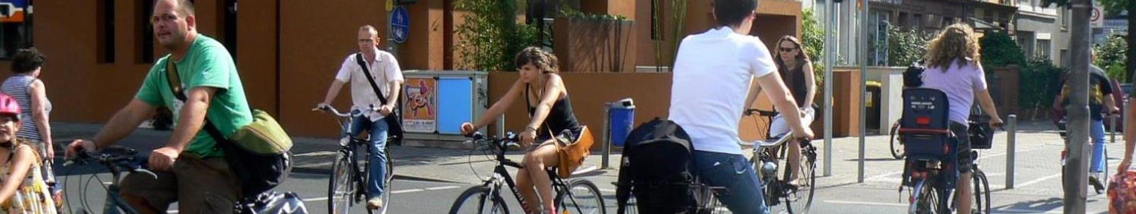
Photo: Climate Alliance Services
Why a reporting platform?
Active involvement of citizens in the exchange with municipalities
cyclists’ concerns are taken seriously
municipalities transparently demonstrate their commitment to cycling
improved cycling infrastructure means more people cycle
Effective, self-explanatory and easy-to-use tool for cyclists and municipalities/administration
Notes:
Is the cycle path all bumpy? The traffic routing too dangerous? Or the signage confusing? Cyclists often have a good eye for potential improvements and damage to the cycling infrastructure they use every day.
The RADar! reporting platform allows German municipalities to easily access this first-hand knowledge and to transparently incorporate it into their planning.
This has three advantages:
Cyclists are taken seriously as road users with the same rights as all other road users.
Municipalities can demonstrate their commitment to promoting cycling in a public, high-profile way.
Targeted improvements to the cycling infrastructure are possible to encourage even more people to cycle.

Slide 26

What is RADar!
Municipal planning tool for cycling infrastructure in Germany
Citizen participation tool
reports can be submitted online or via the RADar! or CITY CYCLING app
municipalities can contact cyclists directly – and vice versa
Optional use by CITY CYCLING municipalities – at no extra cost!
Notes:
Cyclists can use RADar! to submit reports online. They simply need to drop a pin on the digital road map and the municipality will then automatically receive a message. They can then follow up on the report and provide feedback on RADar! about the processing status or by commenting on the report. RADar! can be used for free during the local CITY CYCLING campaign. Cyclists are able to submit reports during the 21-day period that the municipality can access for one year.

Slide 27
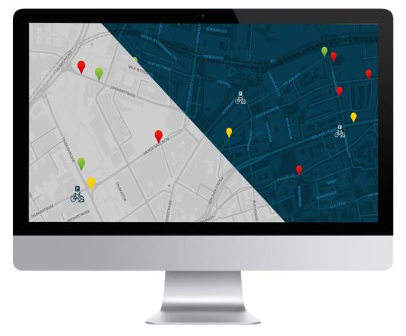
How does it work?
Reports can only be submitted in the municipality’s area of jurisdiction
Only people who have signed up (for CITY CYCLING) can submit reports
fewer “hoax reports”, manageable number of people submitting reports
another reason to participate in CITY CYCLING
Municipalities are free to choose the reporting period:
during the 21-day local campaign
in the summer months
all year round, several times a year
Test phase/manageable period for municipalities
Notes:
Cyclists can use RADar! to submit reports online: they simply drop a pin on the digital street map and the municipality is automatically notified. The reports can then follow up, commented on and the processing status updated. RADar! can be used for free during the three-week local CITY CYCLING campaign. Participants can submit reports, which the municipality can access for one year to review and follow up.

Slide 28
RADar! ONE-YEAR LICENCES
Number of inhabitants | Outside of the local campaign period |  | Without participation in CITY CYCLING
 | Climate Alliance members | Non-members | Climate Alliance members | Non-members
Less than 10,000 | € 110 | € 160 | € 235 | € 325
10,000 to 49,999 | € 175 | € 265 | € 385 | € 530
50,000 to 99,999 | € 235 | € 345 | € 500 | € 705
100,000 to 499,999 | € 285 | € 425 | € 625 | € 925
More than 500,000 | € 350 | € 525 | € 770 | € 1,160
Incl. VAT
Notes:
Licence fees for municipalities when RADar! is booked for one year and the reporting period (meaning the period during which cyclists can submit reports) extends beyond the 21-day local campaign or is offered entirely independently of CITY CYCLING. The processing period (= period during which the municipality can process reports) is fixed at one year. The maximum length of the reporting period is also one year. Municipalities are free to choose when they wish to start using RADar!.

Slide 29
RADar! THREE-YEAR LICENCES
The fees indicated are per year, payable in advance for all three years
Number of inhabitants | Outside of the local campaign period* |  | Without participation in CITY CYCLING
 | Climate Alliance members | Non-members | Climate Alliance members | Non-members
Less than 10,000 | € 80 | € 120 | € 165 | € 245
10,000 to 49,999 | € 130 | € 200 | € 275 | € 405
50,000 to 99,999 | € 165 | € 245 | € 350 | € 525
100,000 to 499,999 | € 205 | € 295 | € 430 | € 650
More than 500,000 | € 250 | € 380 | € 545 | € 810
Participation in CITY CYCLING required in all three years
Incl. VAT
Notes:
Licence fees for municipalities when RADar! is booked for three years and the reporting period (= period during which cyclists can submit reports) extends beyond the 21-day local campaign or is offered entirely independently of CITY CYCLING. The processing period (= period during which the municipality can process reports) is fixed at three years. The maximum length of the reporting period is also three years. Municipalities are free to choose when they wish to start using RADar!.

Slide 30





Key features
Free choice of categories that cyclists can submit reports for
Freely adjustable visibility of report status
Prioritisation of reports by urgency
Comment function for citizens and local administration
Multiple access points and forwarding support with shared responsibilities
Positive reports possible, not just “complaints”
Merging of reports for one and the same issue
Customisable automated emails for new reports
Filter and export functions for subsequent processing
Categorisation according to time commitment: short/medium/long-term
Notes:
RADar! offers all of the necessary settings, comment functions, etc. to ensure that communication between the local administration and cyclists is as smooth as possible.

Slide 31
radar-online.net
Notes:
For more information, see radar-online.net.

Slide 32

Notes:
The third campaign component is BIKE MONITOR, our cycling data portal for German CITY-CYCLING municipalities, which is being completely revamped and expanded for 2025.

Slide 33
Data requirements
for cycling planning
Needs analysis
Conception of new offers
Limited resources
Optimisation of existing offers
Notes:
Transport planners must meet countless requirements.
When only limited resources are available, they need data to be able to prioritise projects. Successes can then be reviewed and target achievement measured – data is also needed for this.

Slide 34
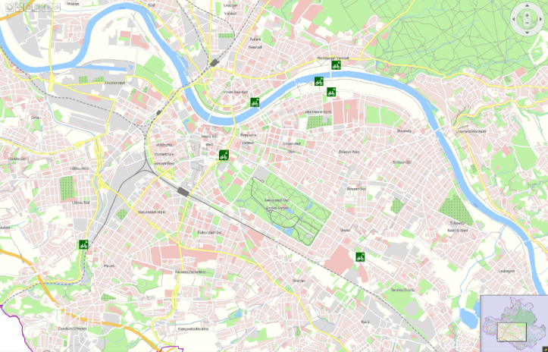
Data availability
for cycling planning
Data situation for motorised individual transport ≠ bicycle traffic
Mostly only traffic measurements at specific points only
Ancillary network not taken into account
Time-consuming data collection
Bicycle counting stations in Dresden Source: Themenstadtplan
State capital of Dresden
Notes:
There is the added issue that little to no data is usually available for cycling planning. Far more data is available for motorised individual transport. Even the survey on mobility in Germany (mobilitaet-in-deutschland.de) does not provide the data needed for cycling planning.
If data is available in a municipality, then mostly not for all areas, but rather only for specific points where measurements are taken. The map here shows the example of Dresden. The green dots are fixed measuring stations. Data collection is extremely patchy as a conquence as the ancillary network isn’t taken into account at all – so the cycling routes away from the main traffic routes or the routes provided by the city.
The (maintenance) costs for measuring stations are also high, as you need things like counting loops in the ground.

Slide 35
Data availability
for cycling planning
Proportion of smartphone users among the German population from 2012 to 2021 (in %)
Number of active participants in CITY CYCLING
since the campaign was launched
Quelle: Statista 2022
Notes:
Smartphones are a good option for obtaining more comprehensive data. The graph on the left shows the prevalence of smartphones in Germany between 2012 and 2021.
At the same time, the number of users needs to be as high as possible and the group of users as heterogeneous as possible (in terms of age, gender, social background). CITY CYCLING meets these requirements ideally with its more than 1 million cyclists in 2024.

Slide 36
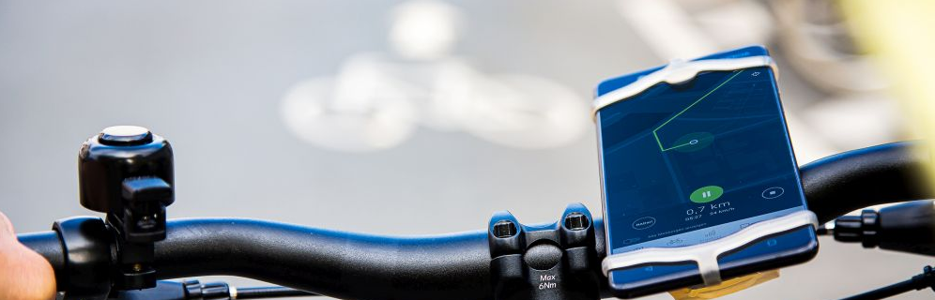
Data requirements
for cycling planning
Photo: Climate Alliance
Where do people cycle?
Who cycles?
Why do people cycle?
How many people cycle?
When do people cycle?
Where do cycle routes start/end?
Notes:
Most municipalities lack the traffic data they need for efficient and meaningful cycling planning:
Where and when do people cycle?
Who cycles and how many people cycle?
Why do people cycle?
Where do people start/stop cycling?

Slide 37

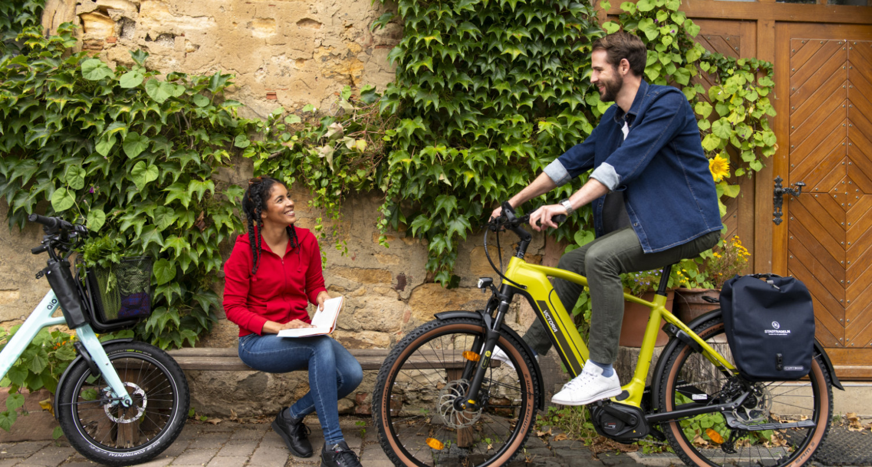
BIKE MONITOR Portal for cycling data
New from autumn 2025
Photo: Climate Alliance Services / Felix Krammer
Notes:
The CITY CYCLING team at Climate Alliance Services plans to provide answers to just these questions and much more from autumn 2025 with its brand-new BIKE MONITOR portal offering high-quality digital cycling data to municipalities in Germany.

Slide 38
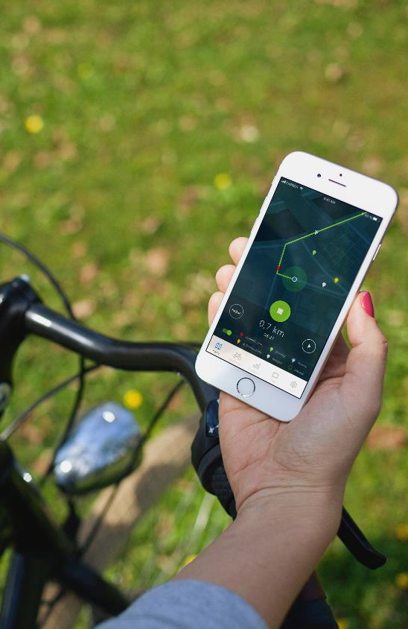
Benefits of BIKE MONITOR the new cycling data Portal
New insights into the average daily (bicycle) traffic, extrapolated based on permanent counting points all across Germany
Improved information on traffic volumes with direction-specific values
New look and feel enabling more intuitive overall use of the portal

Slide 39

Future features
(planned from October 2025)
New information on waiting times, including cyclists who don‘t have to wait
Expanded origin-destination relationships data with graphical improvements and (in future) visible routes between origin and destination
Marking of signposted cycle routes
Integration of data from the official police accident statistics

Slide 40

CITY CYCLING app
Tracking function as the core of data provision
Notes:
It is crucial that people use the CITY CYCLING app regularly –only in this way can reliable data be obtained. Data collection and processing are carried out in compliance with the EU standards for data protection. The data collected is anonymised prior to scientific analysis and used in evaluations and results exclusively as non-personal, factual data.

Slide 41

CITY CYCLING app
7 good reasons to use the app
Good usability and simple tracking
Grow together as a team
Cycling data with added value
Greatest possible data security
Use RADar! to improve conditions locally
From cycling talent to cycling champion
Overview and FAQ on CITY CYCLING
Notes:
The municipalities are called upon to promote use of the CITY CYCLING app among participants in order to obtain as much data as possible and thus sufficient meaningful data for the BIKE MONITOR.
Good usability and simple tracking The app’s menu navigation is self-explanatory and easy to use. Cyclists simply need to click on the start icon in the map tab when they begin cycling and the stop icon when they reach their destination – the kilometres cycled are then recorded and credited to the team and municipality. This eliminates the need to enter data in the kilometre log or log sheet manually and means cyclists always have an overview of the distances they’ve covered at their fingertips.
Grow together as a team Cyclists can see in the app how many kilometres their team has cycled and where it places in the local ranking. The chat function included in the app allows cyclists to cheer their fellow cyclists on or to arrange tours.
Cycling data with added value The information from all of the routes recorded using the CITY CYCLING app flows directly into the scientific evaluation of cycling in the local area. This helps to create a clear picture of the local cycling infrastructure and allows municipalities to see on the BIKE MONITOR (bike-monitor.de) exactly where specific improvements are needed. The more routes are recorded using the app, the more accurate the overall picture and the more a municipality can improve its cycling infrastructure.
Greatest possible data security The data is used exclusively for municipal cycling planning. Data is collected and processed in compliance with the stringent European General Data Protection Regulation (EU GDPR). All data is anonymised before the scientific evaluation and is only included in the results as factual data without any personal data. More information on data protection is available on city-cycling.org/privacy-policy.
Use RADar! to improve conditions locally In the integrated RADar! reporting platform, pins can automatically be dropped in exactly the right place on a digital street map using GPS. There’s also the option of taking a photo using a smartphone and attaching it to the report – provided that the municipality has booked RADar! for the CITY CYCLING weeks or beyond, of course.
From cycling talent to cycling champion Cyclists can earn virtual awards in three categories with the new badge system (see next slides). This should help encourage use of the app in a fun way.
Overview and FAQ on CITY CYCLING Information on what exactly CITY CYCLING is all about, what the rules of participation are and what cyclists need to know about using the app is available under the “Profile” tab.
More information:
city-cycling.org/app city-cycling.org/bike-monitor

Slide 42

CITY CYCLING app
Selected features
Badge award system (gamification)
More statistics on the routes tracked:
average speed
travel time
altitude
Export function for the routes recorded
Notes:
The CITY CYCLING app is continuously being developed further to encourage even more people to use it. An achievement system was recently added (see next slide).
One further enhancement: The kilometres tracked are no longer “lost” in other apps, but can be imported there using an export function.

Slide 43
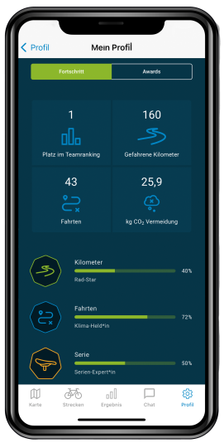
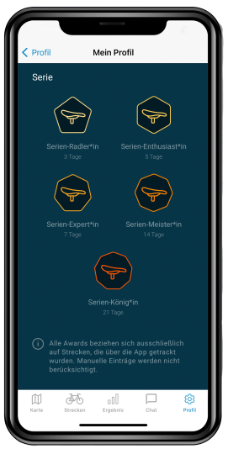
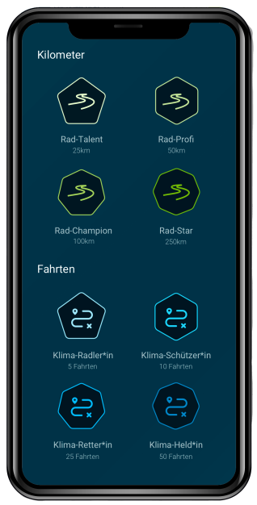
CITY CYCLING app
Badge award system
Notes:
Cyclists can earn virtual awards in three categories thanks to the additional new gamification feature:
kilometres
journeys
series
Cyclists are awarded the “Cycling Talent” badge when they’ve covered 25 kilometres, for example, and the “Cycling Star” badge after 250 km. Similarly, they’re awarded the “Climate Hero” badge after completing 50 journeys. And whoever manages to cycle on all 21 days in a row receives the title of “Series Royalty”!
These awards are intentionally only available to cyclists who use the CITY CYCLING app to track their kilometres so that they “donate” even more (increasingly heterogeneous) data to their municipality.
The use cases developed from this data form the basis for the cycling data offered to municipalities to enable them to better plan their local cycling infrastructure from their computers.

Slide 44
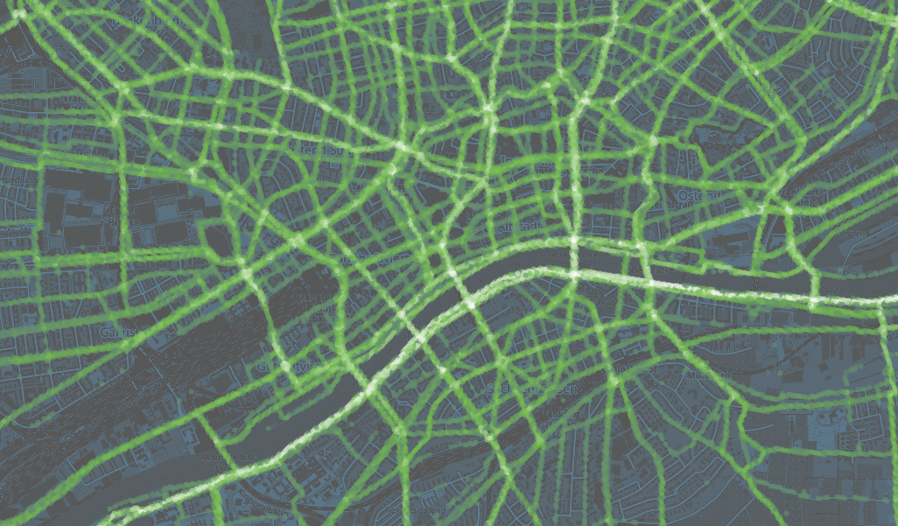
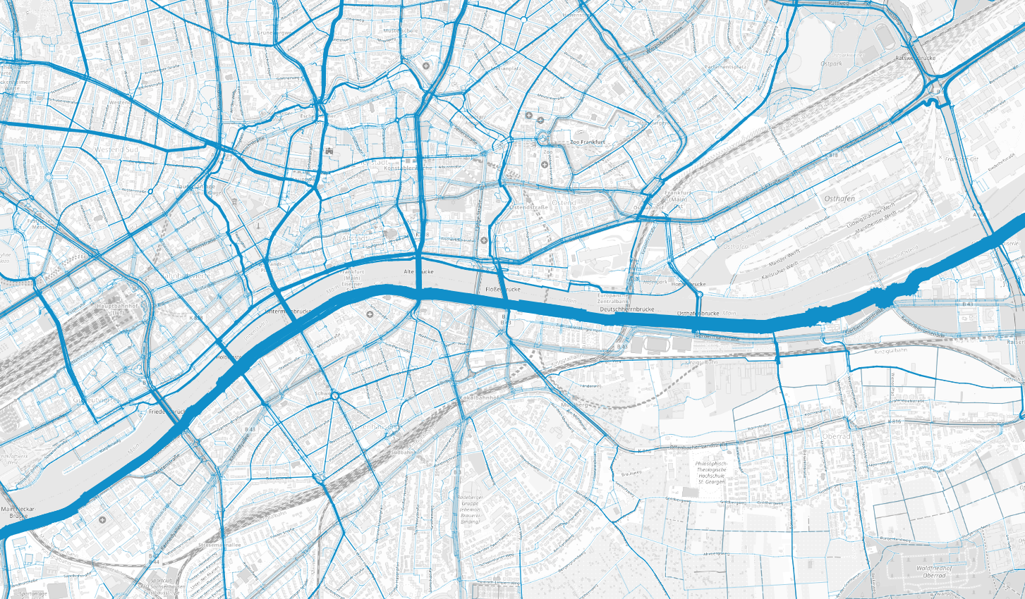
Layer
Heat map & TRAFFIC VOLUMES (demo view)
Notes:
Where do people cycle in your municipality?
The GPS points of journeys covered by bike are projected onto a map. The more GPS points are concentrated on one place, the brighter the points appear. This provides a preliminary overview of the distribution of bicycle traffic in urban areas. The heat map also shows all journeys away from the most popular routes and therefore serves as an important additional tool for interpreting the other analyses.
How many cyclists use which routes?
The traffic volume map shows all journeys completed by bike during the CITY CYCLING campaign. The GPS trajectories of the individual journeys are projected onto the local road network. A total number of journeys per segment is then aggregated for the number of times a route segment is crossed.

Slide 45
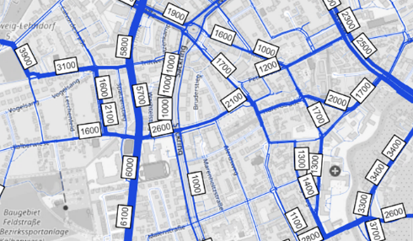
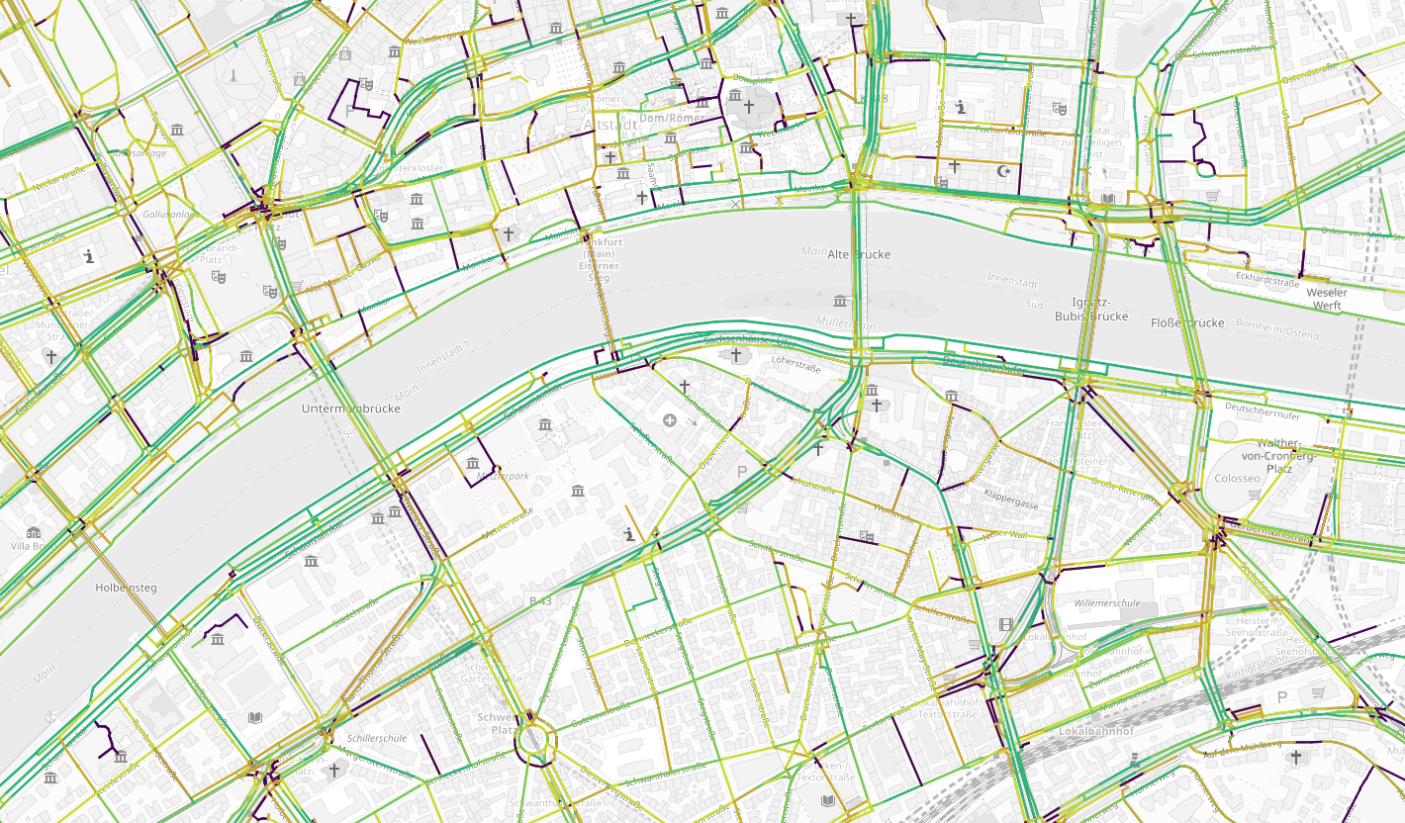
Layer
Average daily traffic scaling and speed (demo view)
Notes:
How can you use synergies with other statistics?
The data on the average daily bicycle traffic is decisive to bicycle traffic planning. By comparing the bicycle traffic volumes with reference data (e.g. from permanent counting points), the volumes can be scaled up to the average daily bicycle traffic. The average daily bicycle traffic on the entire network and also specific routes can then be determined and used for planning.
How fast are cyclists travelling?
The speeds cyclists travel play an important role in determining the quality of journeys completed by bike. The map layer showing the average speeds on individual routes can help to identify sections where cyclists are travelling slower. This can be an indication of a poor road surface or other restrictions that hinder their progress.

Slide 46
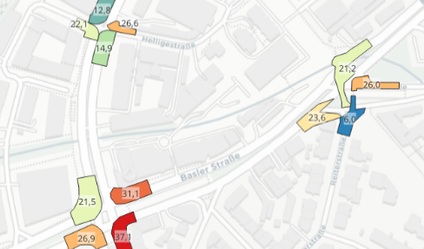
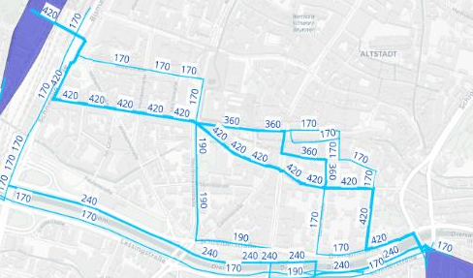
Layer
Waiting times at junctions and origin-destination relationships
(demo view)
Notes:
Where do cyclists have to wait a long time and where do things run (more) smoothly?
Waiting times play an important role in determining the quality of journeys completed by bike. The map layer showing the waiting times at crossroads can therefore help to pinpoint where cyclists have to wait particularly long. This can provide an indication of where the waiting times should be evaluated and reduced in order to speed up bicycle traffic and thus improve traffic quality.
From/to where are cyclists travelling and which routes are they using?
The CITY CYCLING data can be used to show the distribution of bicycle traffic in an area. Understanding the origins and destinations of bicycle traffic and the routes used between these can help in the planning of parking facilities or provide a fundamental understanding of cyclists’ behaviour or the most important cycling routes.

Slide 47
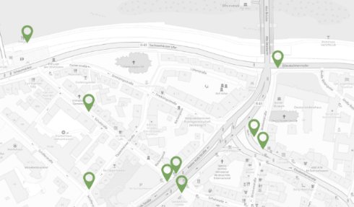
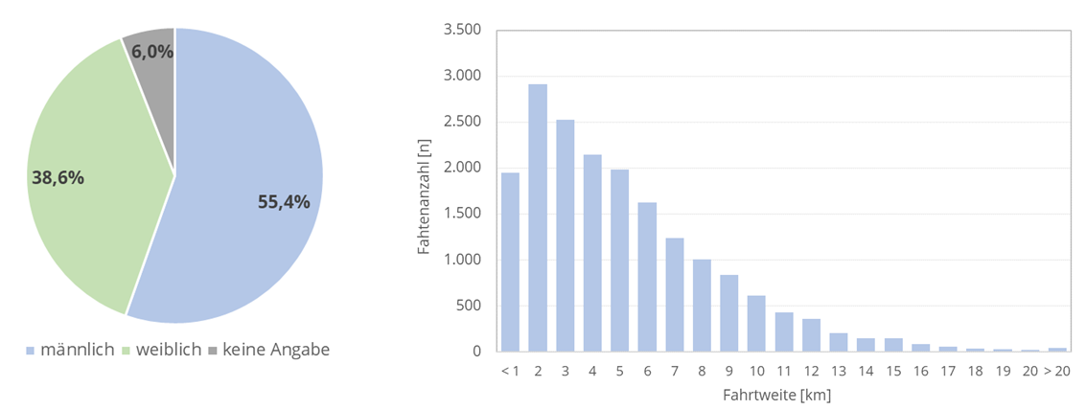
Layer
RADar! layer and Statistics (demo view)
Notes:
How do the RADar! reports influence cycling behaviour?
If a municipality uses the RADar! reporting platform (see slide 24), all RADar! reports including the reasons for these can be viewed. Allowing planners to compare these with the reports linked to other data (such as cycling speeds or traffic volumes) and determine whether any correlation exists, for example.
What does the data tell us?
To be able to interpret the data properly and draw the correct conclusions, we need more information about the data collected. The statistics section provides additional anonymised information, clarifying the scope and quality of the underlying data, allowing the findings to be taken into account accordingly.

Slide 48
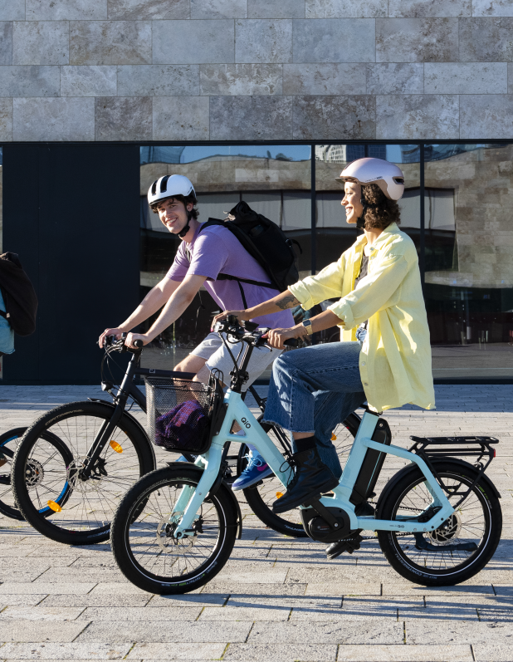
Aims of the new cycling data portal
Support municipal cycling planning
Valid, representative data
Improved analysis algorithms for data processing
Continuous data acquisition and automated data processing
Applicable to as many municipalities as possible
Photo: Climate Alliance Services / Felix Krammer
Notes:
Advantages compared to other providers:
Participants in CITY CYCLING provide an excellent basis for representative and valid data.
Heterogeneous CITY CYCLING user groups: people of all ages, genders and social backgrounds.
In contrast, mainly (around 80%) males aged between 25 and 40 years old use “sport apps”.
Improved analysis algorithms for data processing
Data from many other providers is a “black box”: municipalities often don’t know the conditions under which the data was collected and processed.
The data obtained is of a low quality as a consequence and often unsuitable for bicycle traffic planning.

Slide 49
App usage
In 2024:
6.9 million journeys by bike
56.1 million kilometres cycled
216 terabytes of data
40% app usage among all CITY CYCLING participants
App users
Notes:
Bearing in mind that about one quarter of all participants also enter the kilometres cycled by other people (e.g. a school class or family members), then these statistics and usage rates are very good.

Slide 50
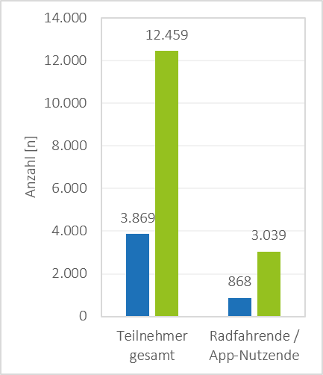
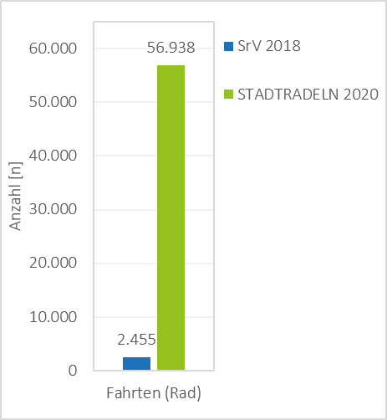
Data source
Sample figures (example of Leipzig)
Comparison of CITY CYCLING and the survey on urban mobility in Germany
Teilnehmer
Notes:
Take the example of Leipzig: significantly more people participated in CITY CYCLING in 2020 than they did in the survey on urban mobility in Germany.

Slide 51
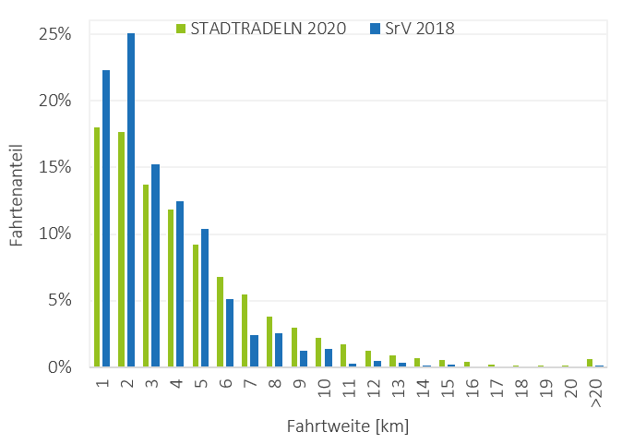
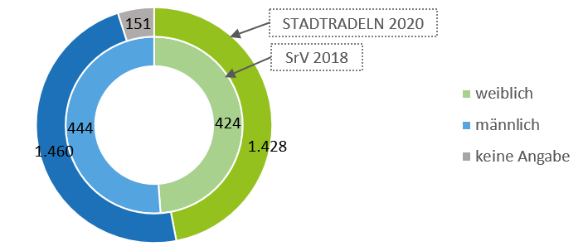
Data source
Sample figures (example of Leipzig)
Comparison of CITY CYCLING and the survey on urban mobility in Germany
Notes:
Households in German were surveyed on urban mobility.
Gender distribution + travel distance distribution for Leipzig, also for 2020.
The gender distribution is balanced and also better than it is in other apps where the gender ratio is often around 80% men, 20% women.
The distances travelled are based on those used in the urban mobility surveys.
This shows that data preparation works!

Slide 52
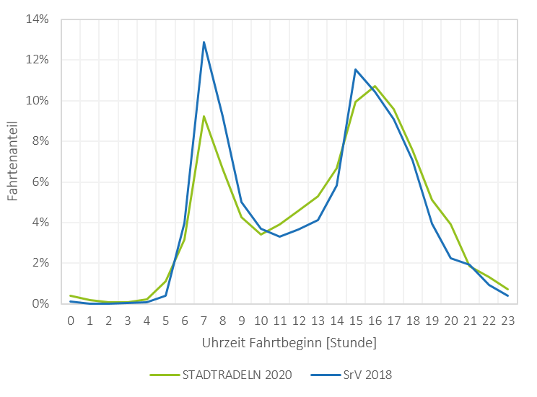
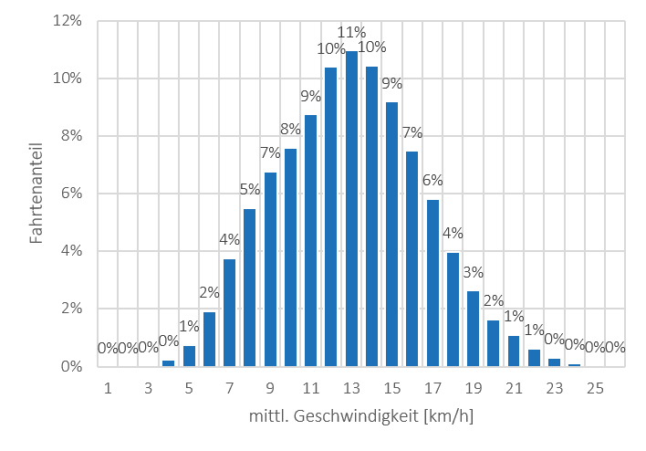
Data source
Sample figures (example of Leipzig)
Comparison of CITY CYCLING and the survey on urban mobility in Germany
Notes:
Travel start time and distribution of the mean speeds for all journeys in Leipzig in 2020.
Here too, the data is similar to the data from the mobility surveys of households.

Slide 53
bike-monitor.de
New from autumn2025
Notes:
The third component of the campaign is the BIKE MONITOR cycling data portal, which is being entirely revamped and expanded for 2025.

Slide 54
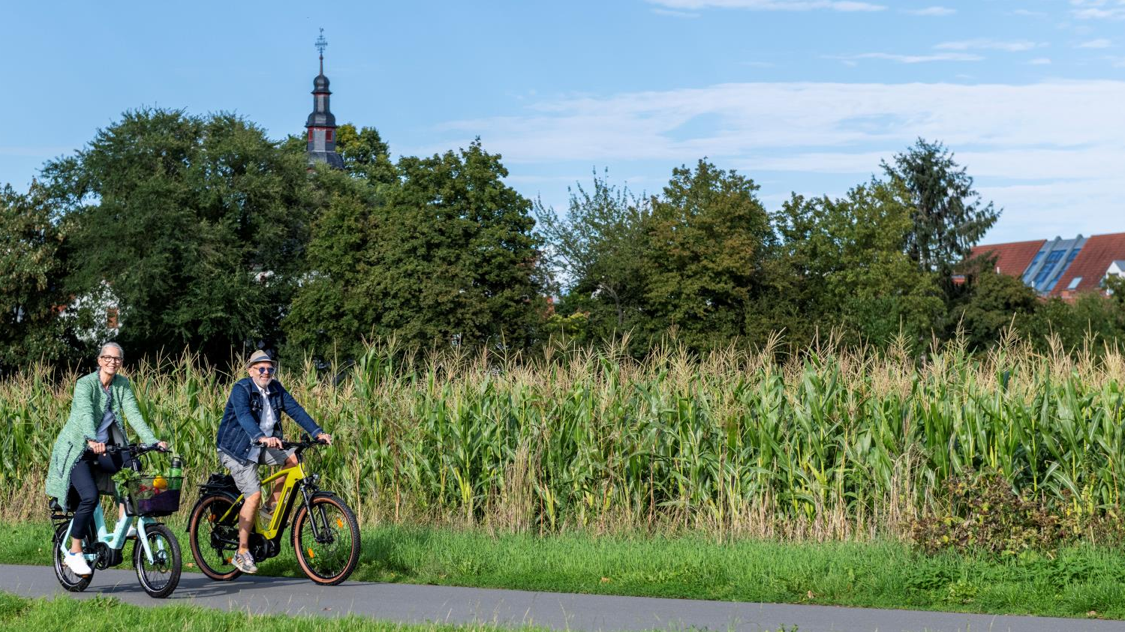
CITY CYCLING, RADar! & BIKE MONITOR
An all-in-one tool
for communication, planning and citizen participation
Photo: Climate Alliance Services / Felix Krammer
Notes:
With its integrated RADar! reporting platform and BIKE MONITOR, CITY CYCLING offers a unique all-in-one package!

Slide 55



Thank you!
CONTACT
<Name> <Organisation> <Function> E. T.
CITY CYCLING Team E. info@city-cycling.org T. +49 69 717139-39
Climate Alliance Services
Eschborner Landstraße 42 – 50 60489 Frankfurt am Main Germany
W. climatealliance.org E. europe@climatealliance.org
city-cycling.org
radar-online.net
bike-monitor.de
Notes:
Please add your contact details to this slide!

Slide 56

Climate Alliance
1990 Establishment of the European network of cities, municipalities and counties for protection of the global climate as an association
2023 Spin-off of Klima-Bündnis Services GmbH into which CITY CYCLING has been integrated since 2024, with the association as a 100% shareholder
Today, Climate Alliance has around 2,000 members in over 25 countries in Europe:
approx. 90 million people live in a Climate Alliance municipality
more than 20% of the EU population
Partnership between European municipalities and indigenous rainforest peoples to reduce greenhouse gas emissions and protect the rainforests
Notes:
Some information on Climate Alliance to finish up – as general background to the whole project.

Slide 57
Climate Alliance
When municipalities join Climate Alliance, they commit to:
continuously reducing their greenhouse gas emissions by 30% every 5 years, with the goal of cutting CO₂ emissions by at least 95% by 2050 (compared to 1990)
halving their per capita emissions by 2030 at the latest (base year: 1990) by
saving energy
using energy efficiently
opting for renewable energies
meeting the long-term goal of 2.5 t of CO₂ emissions per inhabitant and year

Slide 58
Climate Alliance
European Secretariat
Climate Alliance activities
exchange of experience and advice for members
development of methodological approaches to municipal climate action
cooperation with indigenous peoples
representation of municipalities’ interests on the national, European and international levels
conception and coordination of campaigns

